Slide 1
T1A2 Portfolio
Bailey Evans

Slide 2
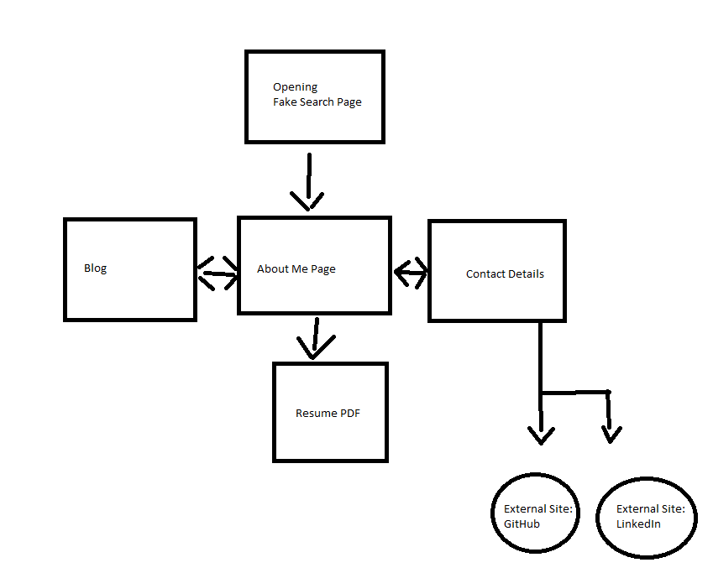
Sitemap

Slide 3
DESIGN GOALS
Fluidity
Interactivity
Responsiveness
Visual Engagement

Slide 4
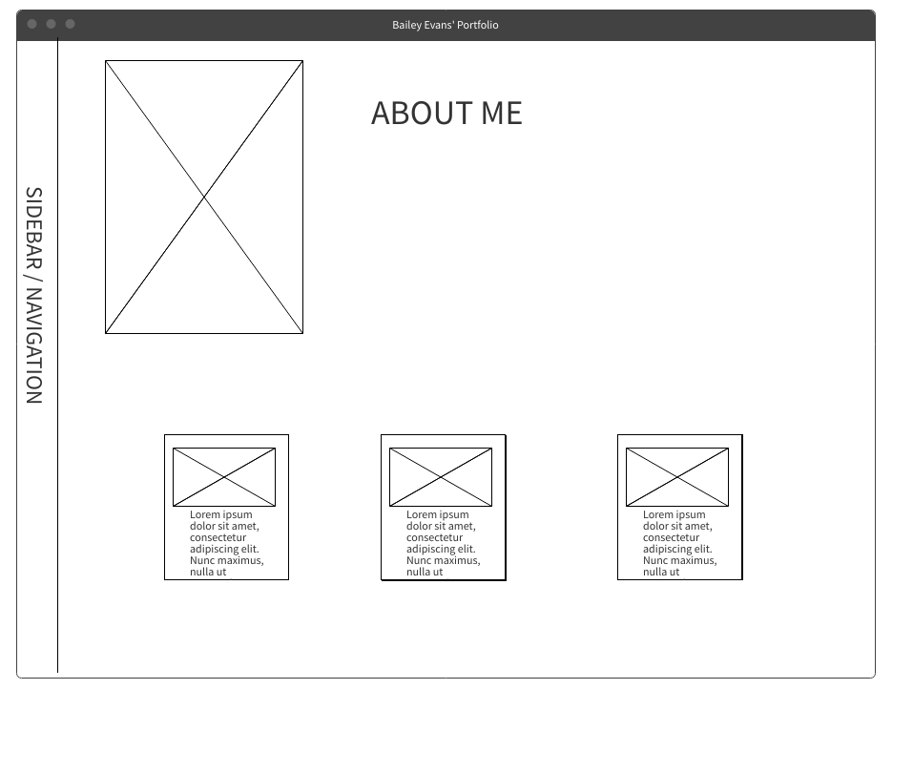
WIREFRAME – ABOUT ME PAGE

Slide 5
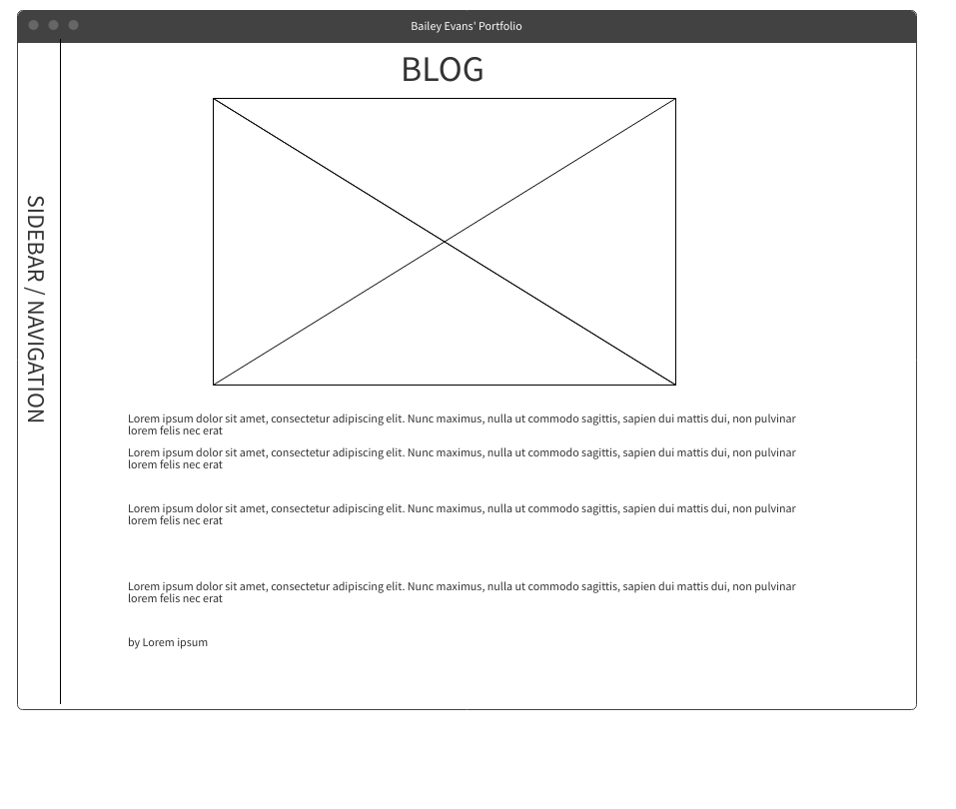
WIREFRAME – BLOG PAGE

Slide 6
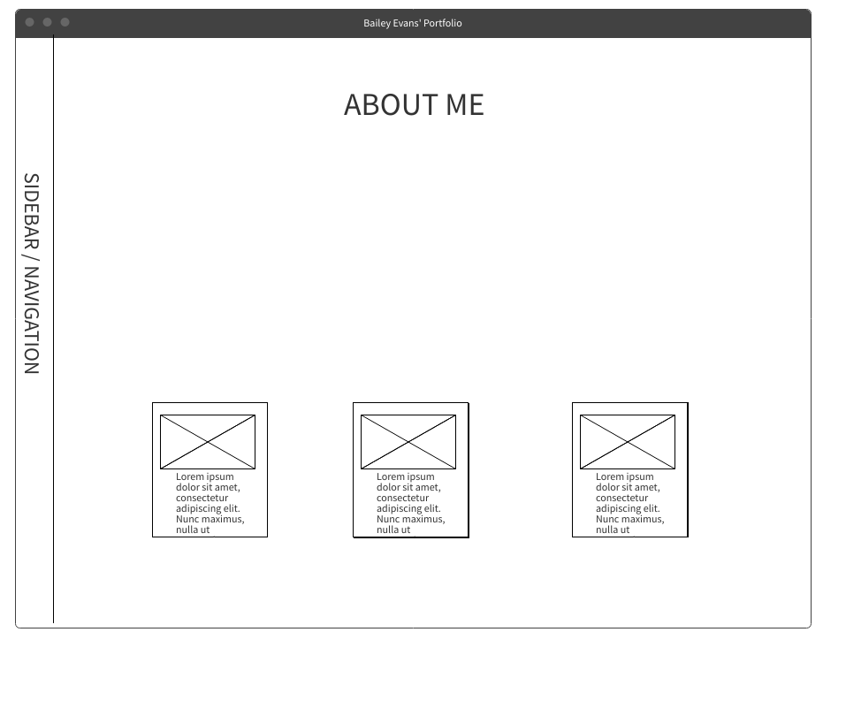
WIREFRAME – CONTACT PAGE

Slide 7
COMPONENTS
Documented and organised
STYLING
Friendly Colour Palette
ANIMATION
Catch Viewer Attention
IMAGERY
Visual Engagement
Accessibility on all devices
SEMANTIC HTML
RESPONSIVE

Slide 8
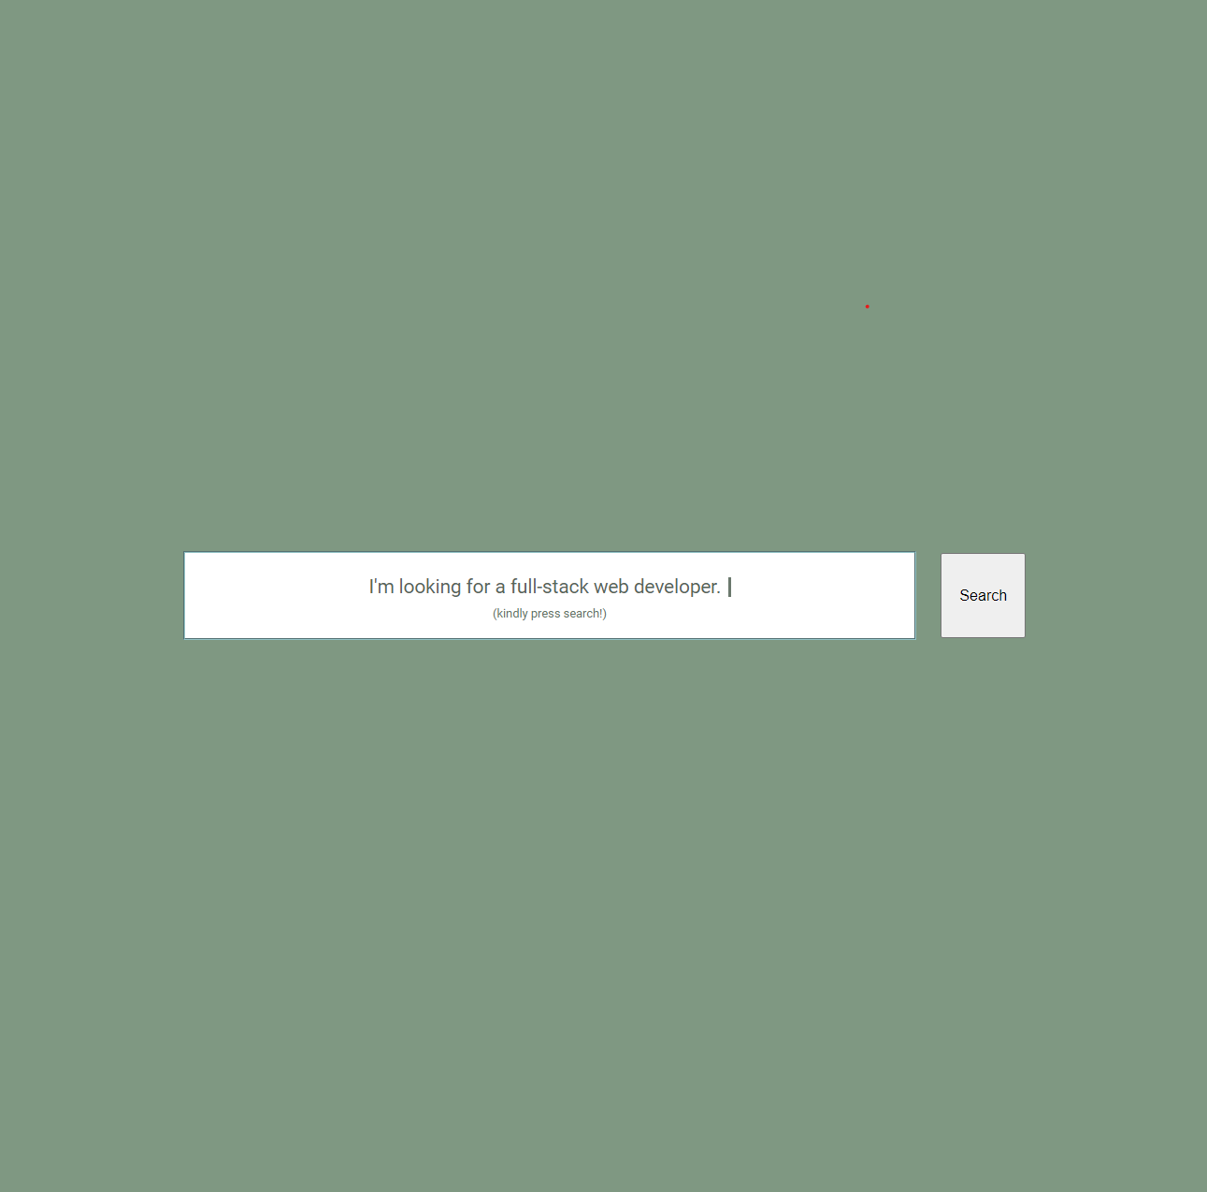

Slide 9
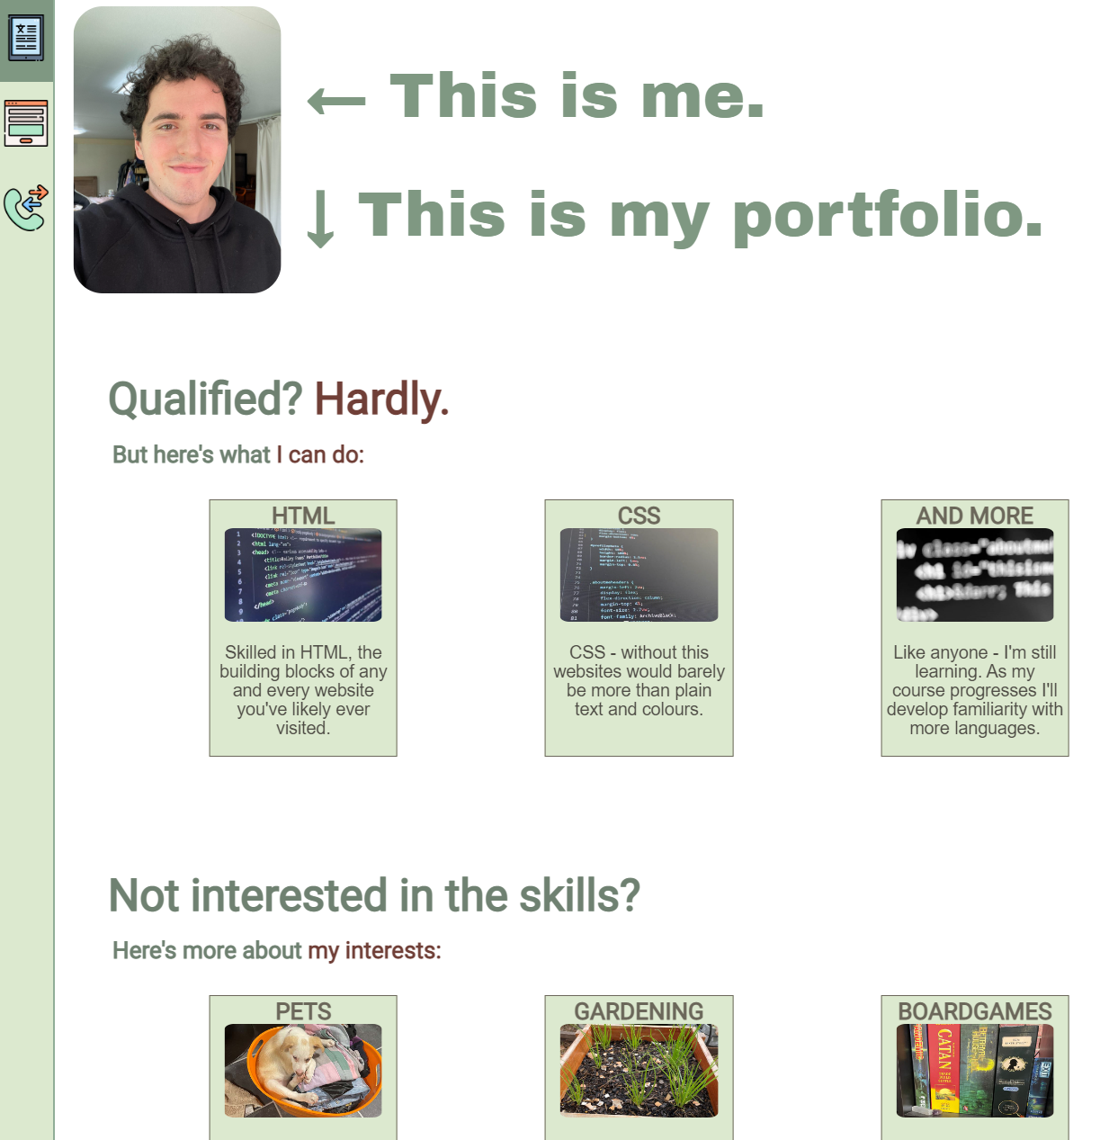

Slide 10
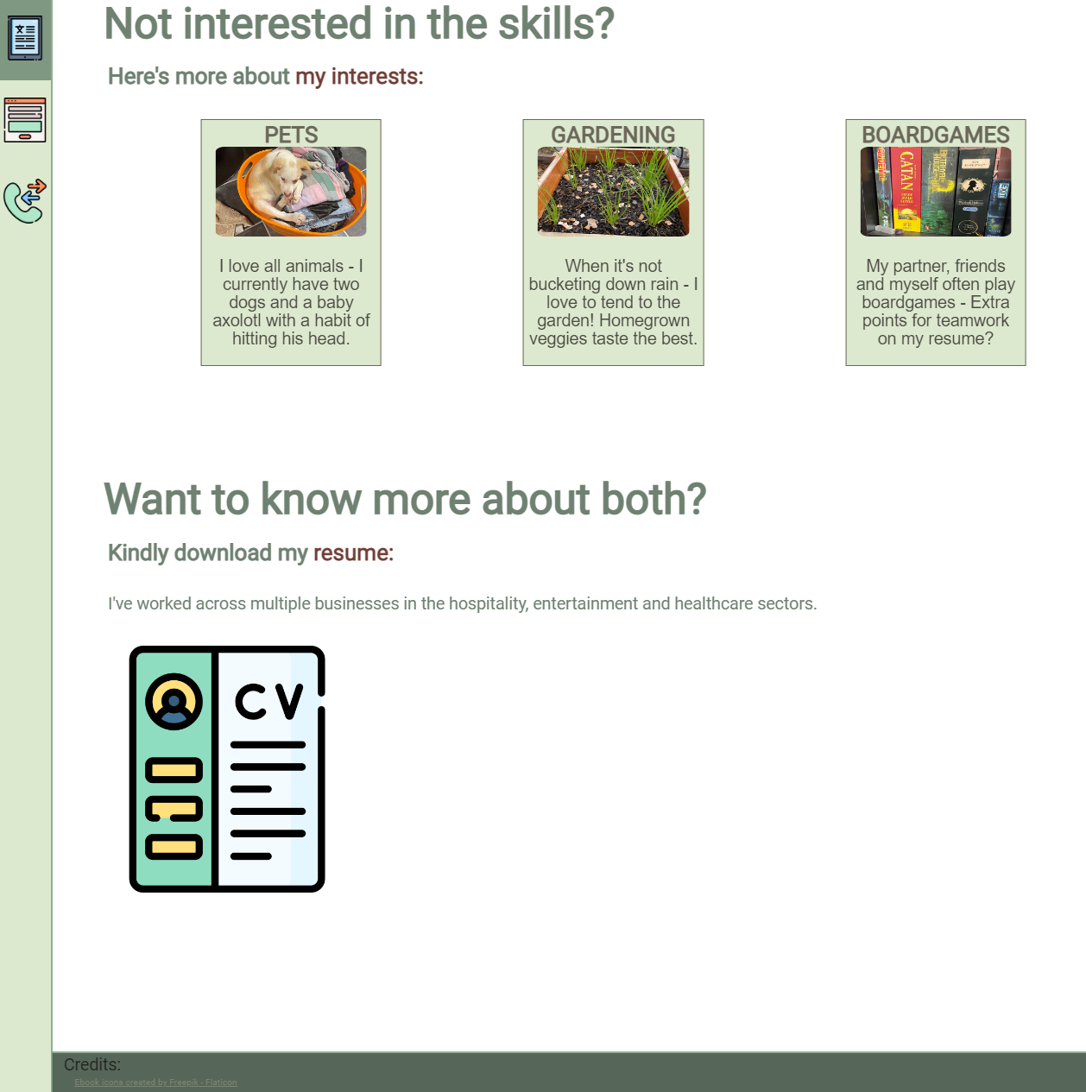

Slide 11
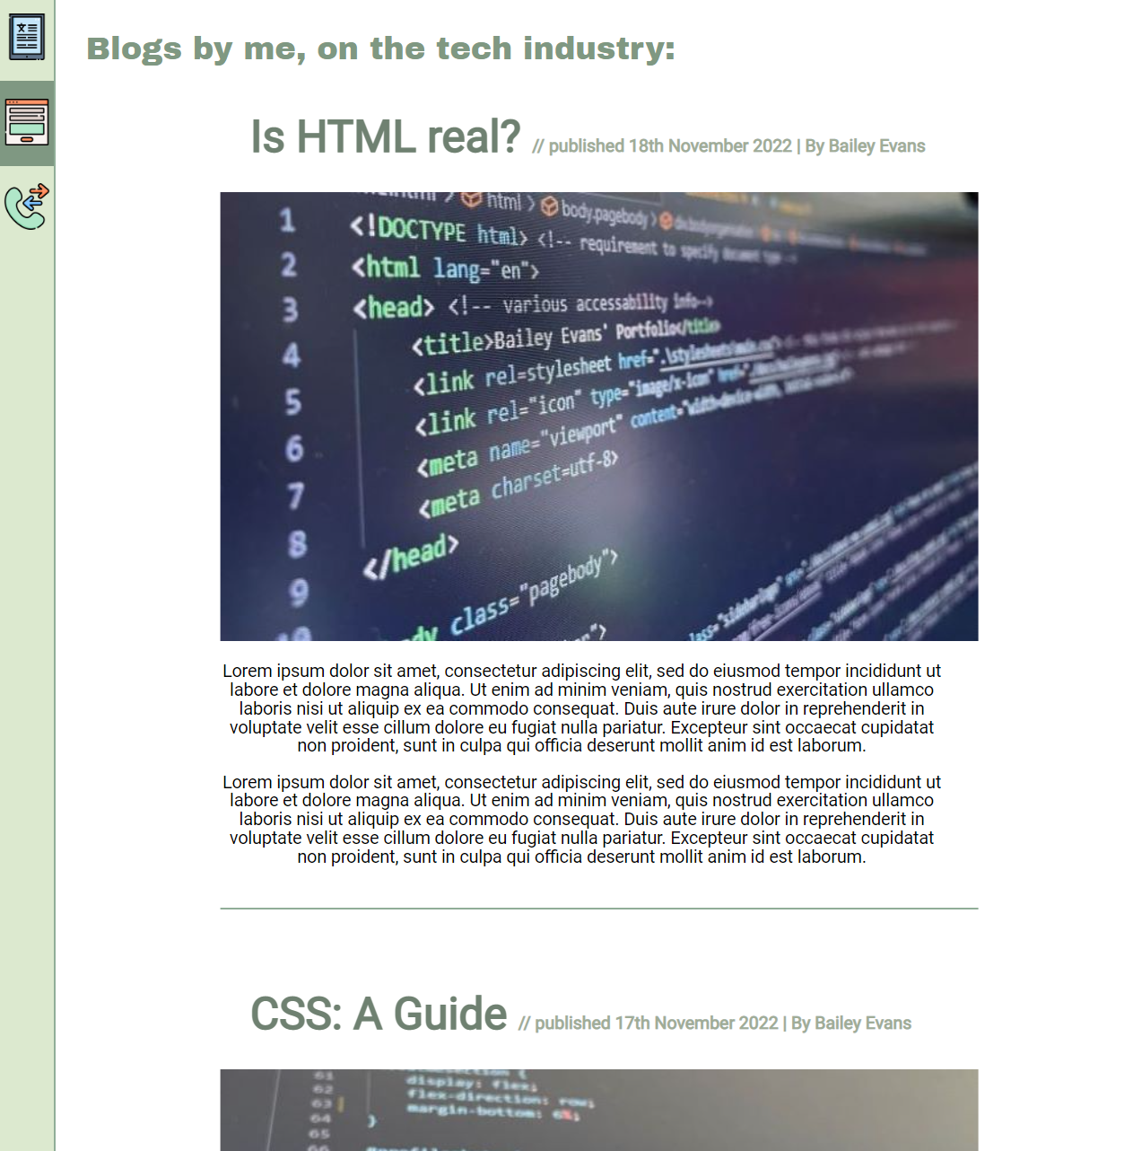

Slide 12
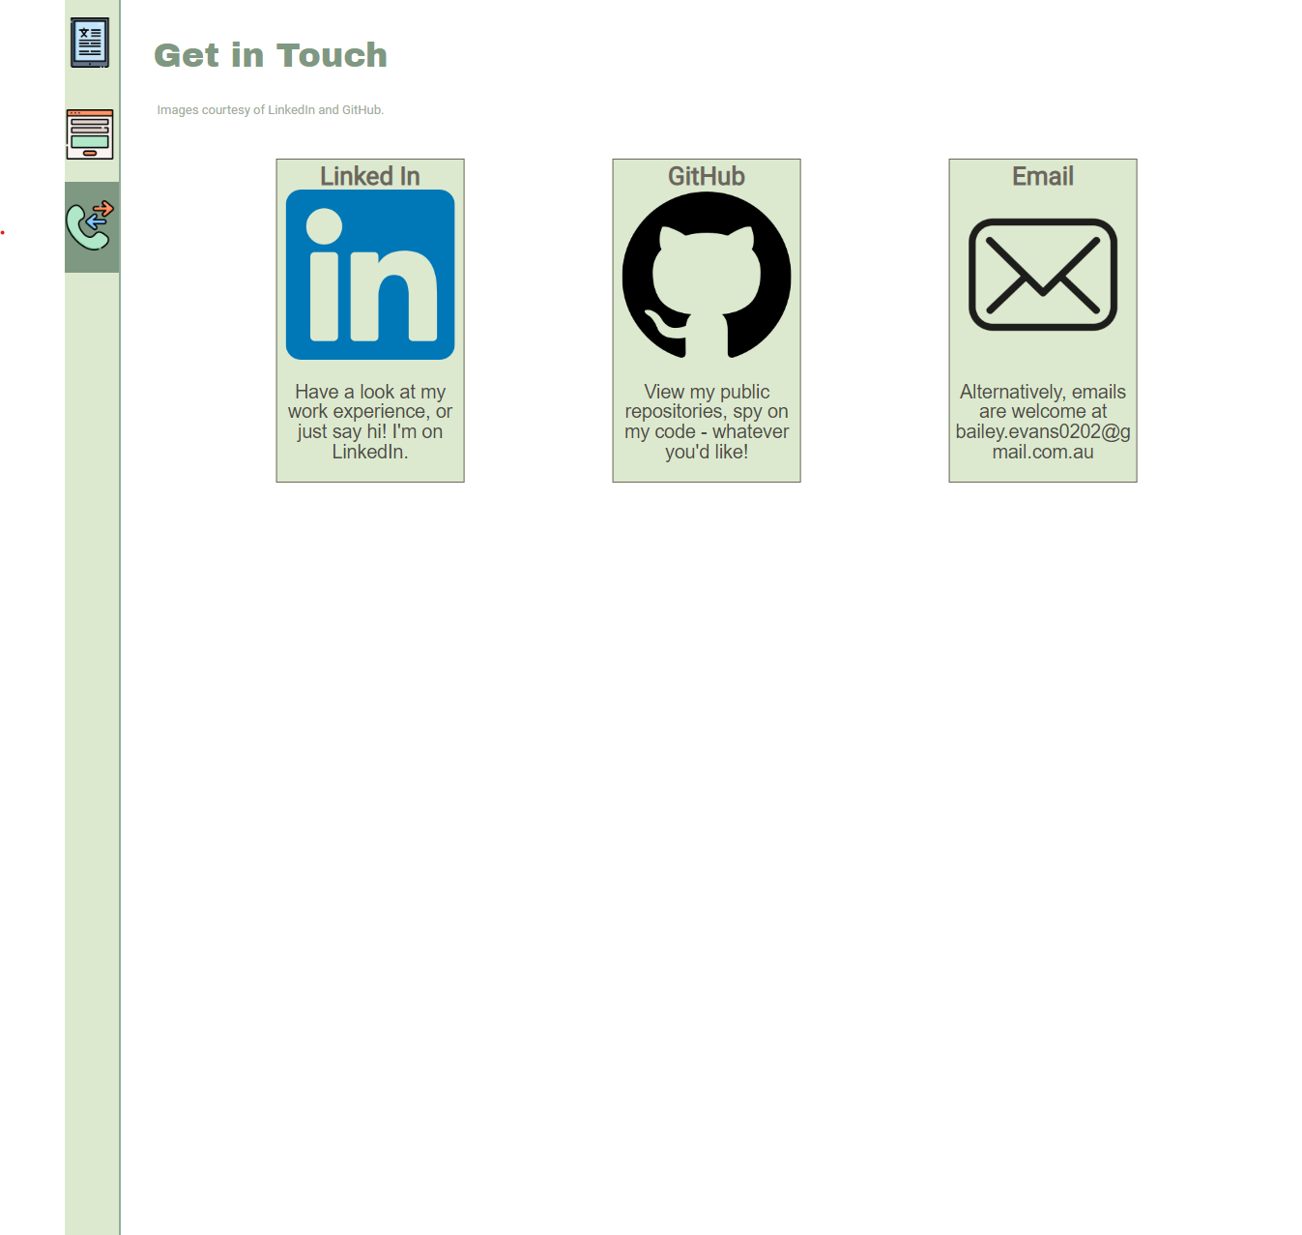

Slide 13
REVIEW
Challenges
Ethical
Favourite Parts
Maintaining Layout whilst being responsive.
Work Load per Day.
Animation & Colour.

Slide 14
THANK YOU
Bailey Evans
bailey.evans0202@gmail.com
https://github.com/Bailey117/t1a2-portfolio

